Slide 1
DYNAMIC FEE PROCESSOR
DEVELOPED BY
MOPARTHI YASESWANI
MEKAPATI RUPAMBIKA
PEDDINTI MURALI
PASUPULETI ANAND

Slide 2
OUR PROBLEM STATEMENT
TO CREATE A WEB APPLICATION FOR ANALYZING THE UNIVERSITY FEE PARTICULARS.
(WHICH INCLUDES THE STUDENT TO KNOW ABOUT THEIR FEE STATUS).

Slide 3
ABSTRACT
Fee department in universities facing many issues for maintaining students fee records of bulk without errors. To reduce their burden, we designed this website. This website can enable fee department admin of an university to analyse , monitor the fee particulars of a student . Admin can easily upload bulk fee data of individuals , we will process data and provide the statistics with required patterns. Students can easily know their data through this website where we will display the details of respective students. This website made the fee department online mode through which they will save the records without any errors and can store them for long life.

Slide 4
TECHNOLOGIES USED
FRONTEND:
1.HTML
2.CSS
BACKEND:
1.PYTHON
2.PHP

Slide 5
EXISTING SYSTEM
Existing is offline mode fee data management.
Fee department in universities have been facing problem of maintaining each student record.
For a university or any college fee department it will be difficult to maintain a longtime data.
Single student facing many problems for knowing their own fee data.

Slide 6
PROPOSED SYSTEM
We have developed this website to dynamic process of fee data management.
In implementation,we have implemented this in two perspectives that is student panel,admin panel.
Coming to admin panel,Admin no need to maintain the data manually,he can maintain it in excel sheet and at the end of the day they can upload in our website through which we have provided access to upload the file.
Coming to student panel,Student can able see his total fee data upto now in this website which includes data,time of amount payment .

Slide 7
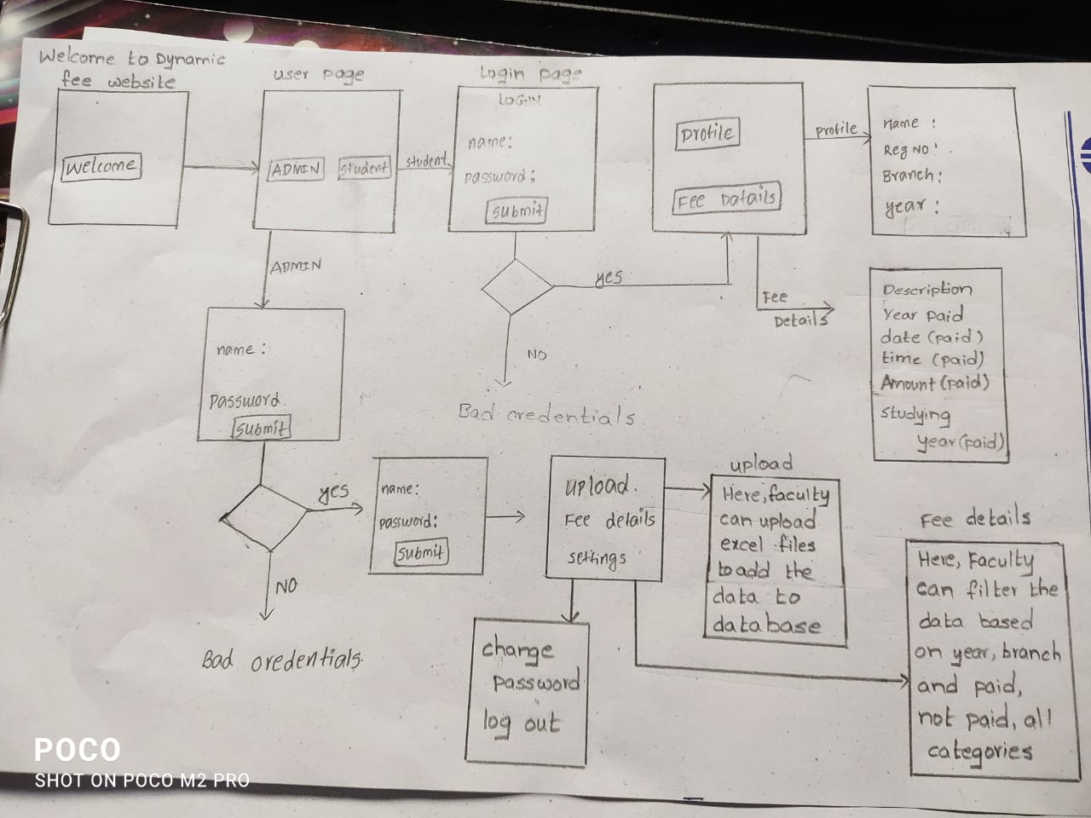
ARCHITECTURE

Slide 8

DYNAMIC FEE PROCESSOR
WE HAVE IMPLEMEMTED OUR PROJECT IN TWO PERSPECTIVES NAMED AS:
STUDENT PANEL
ADMIN PANEL

Slide 9
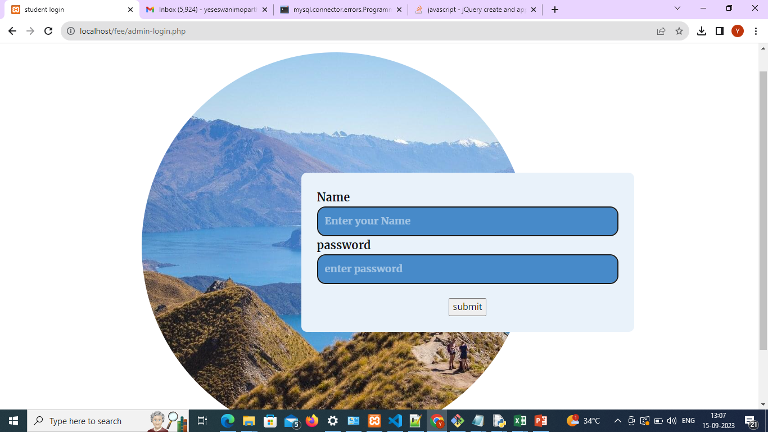

Slide 10
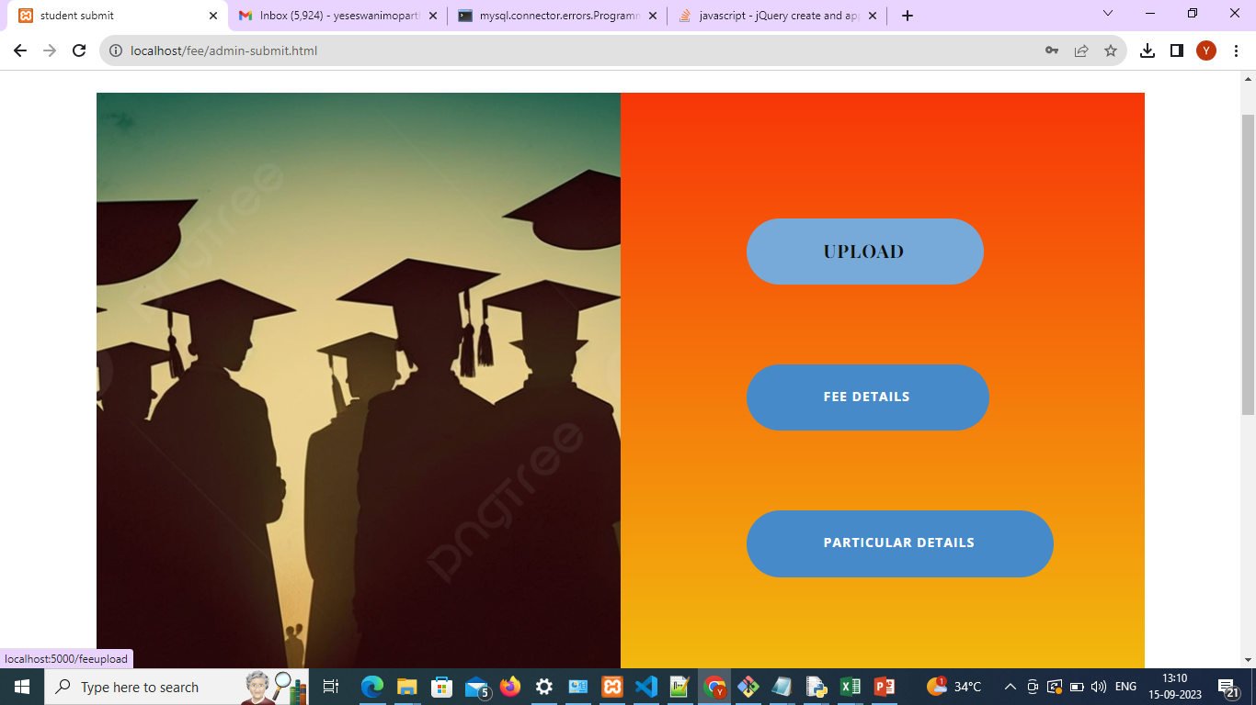

Slide 11
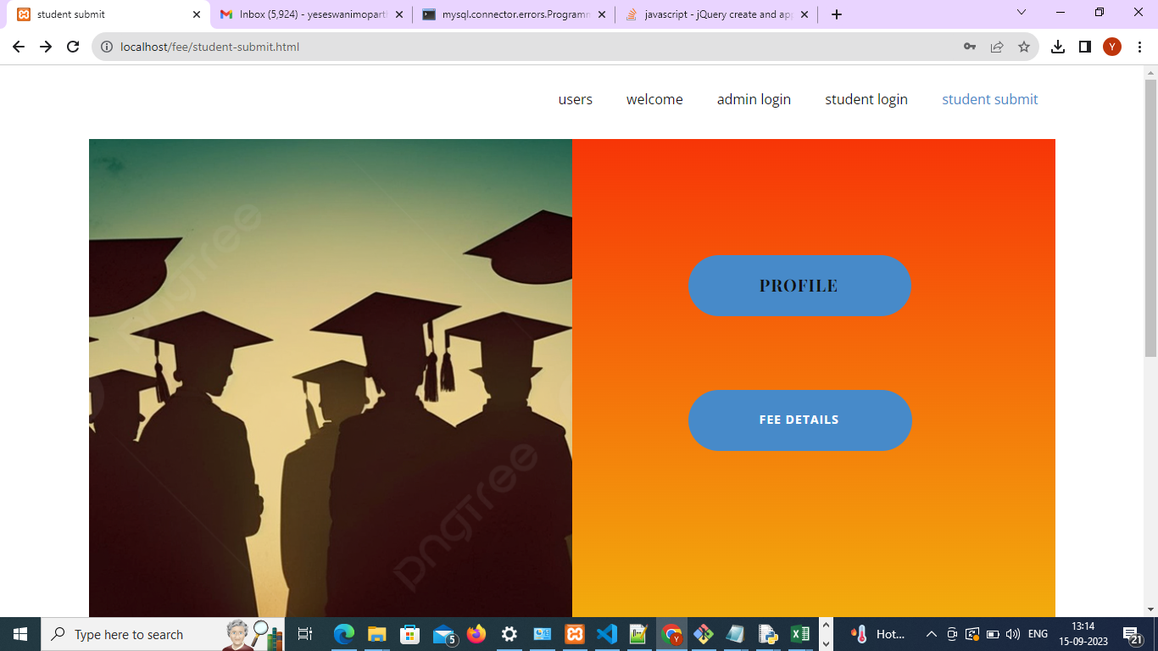

Slide 12
Let’s have a look at our website!

Slide 13
THANK YOU

